Slide 1
Introduction to Artificial Intelligence & Machine Learning

Slide 2
Agenda
Introduction to machine learning
What is machine learning?
Applications of ML
Data Science Process
Supervised Vs Unsupervised Learning

Slide 3
AI/ML opportunities
AI/ML opportunities
Value creation
Cost differentiation
New products (Internal & go-to-market)
Chabots and virtual agents
NPS enhancement
Customer & call center intelligence
OpX automation
Business rules to ML models
Data quality enhancement
Data enrichments
Decision support/augmentation
3
Notes:
changed

Slide 4
Visual Definitions
The field of Data Science
AI Vs ML Vs DL
Field of artificial intelligence
Field of machine learning
Deep
learning
4
Notes:
changed

Slide 5
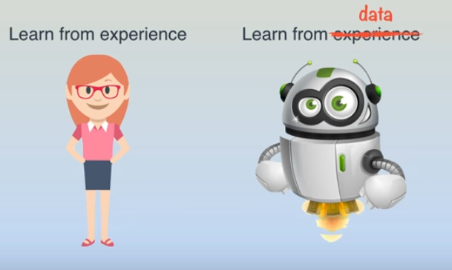
What is Machine Learning?
Not a rocket science.
Humans vs Machines
Humans learn from experience but machines need to be explicitly programmed.
Can a machine learn from experience??

Slide 6
Machine Learning Overview
Rules
Classical Programming
Answers
Data
Data
Machine Learning
Rules
Answers
Machine Learning (ML)
ML is a subfield of computer science and artificial intelligence (AI), which deals with building systems that can learn from data, instead of explicitly programmed instructions. With ML we can teach a system to organize, learn, describe, and generate predictions.
It uses algorithms to learn the data
Algorithms can be applied to real-time, near real-time and offline data

Slide 7
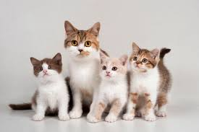
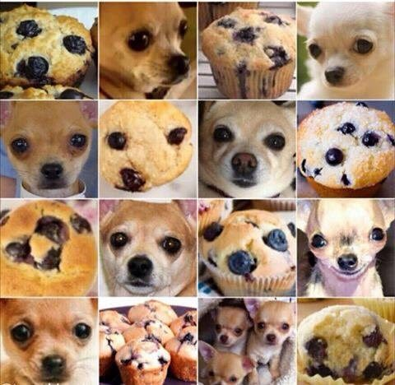
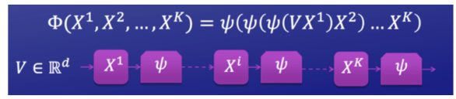
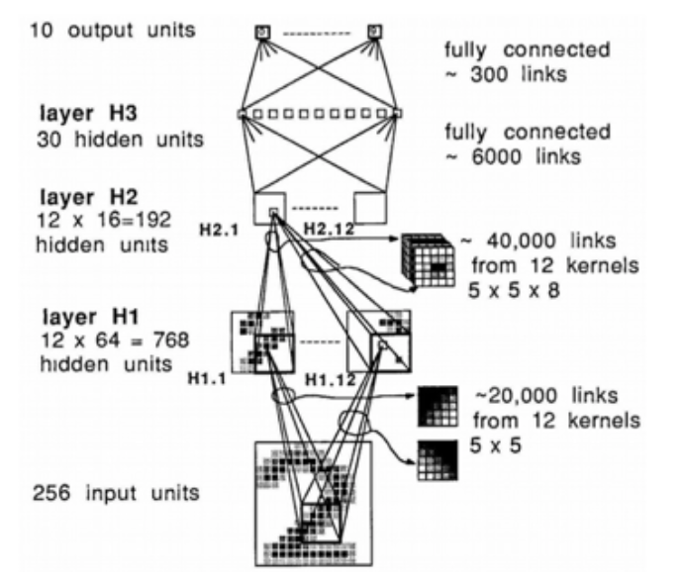
Why can’t I just write rules (they are so easy!)?
If ears = yes and
tail = yes and
cute = yes
then
“Cat”
else “Not Cat”
Notes:
Rules appear to be easier, but as the problems get harder the rules get incredibly complex!
So using my simple code above, you’d probably get a high degree of cats, but how do you program cute? Or find a tail?
Machine learning doesn't’t see cats above, it sees math and the math can be generalizable to see things like shape of head, etc.
So even in the cat example above, you could reasonably write a program, but what if the question was dog or blueberry muffin? That’s a pretty significant problem that you probably could code in rules but boy it would take a long time

Slide 8
Cat Machine Learning
Pictures
Data
Machine Learning
Rules
Pictures identified with cats
Answers
Notes:
So machine learning is actually “easier” than the rules here, as you just feed it a bunch of pictures with some of them pre-identified as cats and the algorithms figure it out

Slide 9
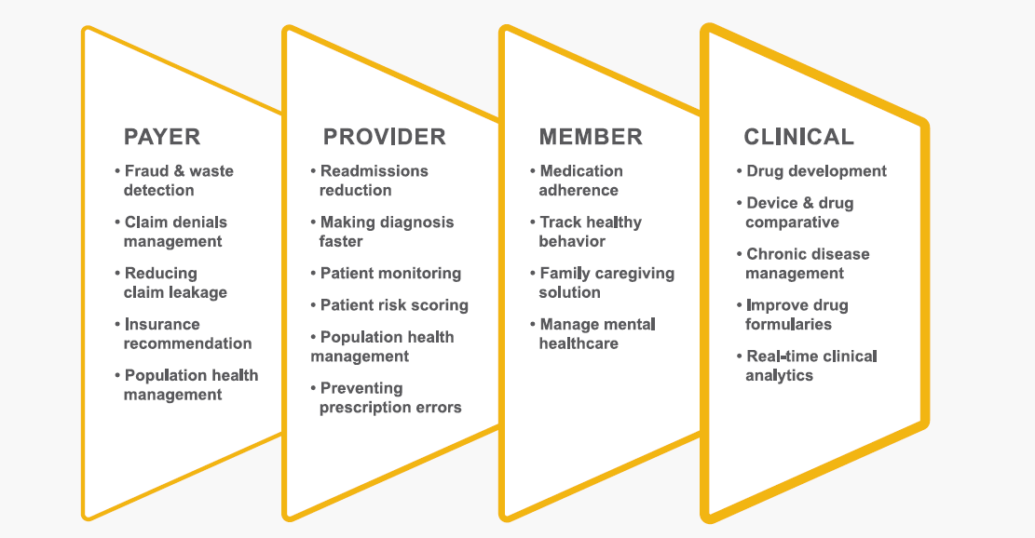
Data Science in Healthcare
Notes:
HEALTH CARE IS A DYNAMIC CHANGING MARKET
• As you know, the health system is very different today than just a few years ago. We see the landscape being fundamentally transformed by two major forces:
• At the center of the first force are the participants with the greatest stake in a better-performing health system: consumers.
• They are more engaged and empowered than ever before as their mindset changes from “my health, your money” to “my health, my money.” And increasingly, they want it “my way.” They need expert guidance, education and resources to find the right care and services, at the best value – on their terms. These terms are more mobile and easier to use.
• The second major force is the focus on value, and that is being led by an improved clinical model, as patient care is provided, managed and paid for with an eye squarely on higher quality at lower cost. Fee-for-value is becoming the dominant payment model in the health system as care providers take on more accountability.
• These two forces are converging to drive three critical goals we all share across the health system:
o Better experiences for everyone involved in and using the system, especially consumers;
o Improved health outcomes on a consistent and sustainable basis, to drive better overall population health; and
o Reduced costs across the system
• And today, we have more innovative technologies, insight-rich data and collaboration tools than ever to advance these goals.
• Ultimately, health care needs change agents with the determination and ability to:
o First, implement the changes that accomplish these goals;
o And then operationalize them to encourage and enable the broader health system
In Technology we sit in a very unique position in the intersection of the Health Care transformation and Technology transformation.
Right now is the opportunity for us to understand the how health care is changing and the opportunities those changes present to us as well as how we can leverage the new technologies more effectively as we deliver these solutions.
This is a very unique time for the health care marketplace.

Slide 10
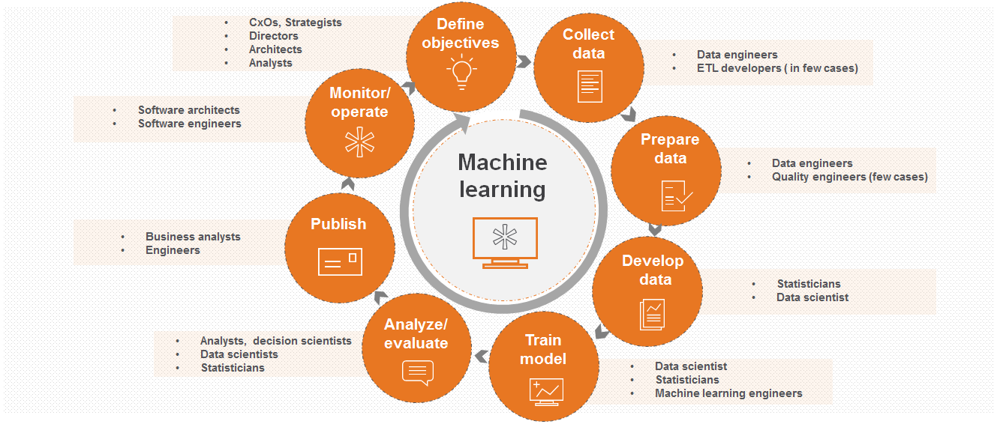
Machine learning life cycle – which lives
10

Slide 11
Supervised vs Unsupervised
 | Supervised | Unsupervised
Description | All data is labeled. We know the true value of an outcome, then predict it. The image is labeled by an expert and we try to learn the labels Success is measured by a loss (error) function | There are no labels The machine learns to describe the data The description is subjective -- without labels there is no error function Needs more expert advice to aid the machine
 | Numeric Labels Linear Regression Generalized Linear Models Decision Trees Random Forests | Clustering K-means Hierarchical Clustering Dimensionality Reduction SVD PCA Association Analysis Apriori
 | Categorical Labels (Yes/No; 0/1; or many) KNN Trees Logistic Regression Naive-Bayes SVM

Slide 12
Machine Learning steps
Understanding the
Business problem
Dataset Extraction
Learning Algorithm
Training Data
Train Model
Feature Engineering
and EDA
Data cleaning
Test Data
Score Model
Evaluate Model
Deployment

